Slide 1
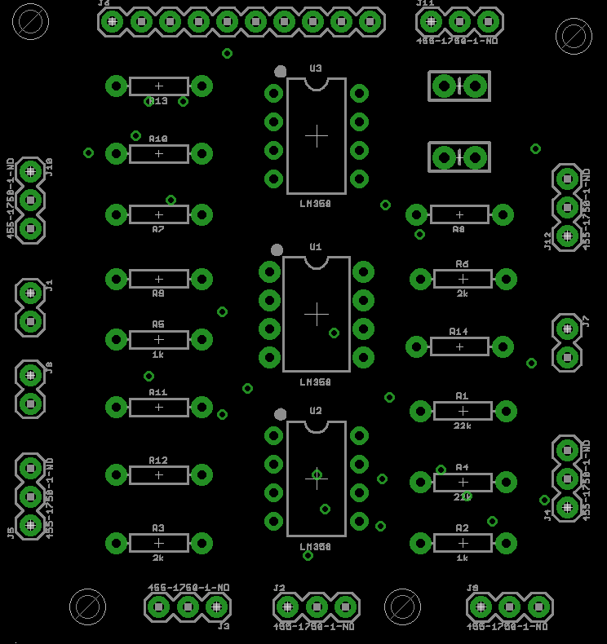
Treasure
out
1 2
- Phototransistor closes
+ this open circuit
Phototransistor closes -
this open circuit +
VCC (Treasure 2)
GND (Treasures)
VCC
Treasure 1

